Slide 1

Learning Religious and Moral Values For Early Childhood Using a Neuroscience Approach
By
Prof (Dr.) Nasrin
Chairperson Department Of Education
Aligarh Muslim University,
Aligarh ,202002 UP

Slide 2
Neuroscience
Neuroscience is the scientific study of brain and the nervous system.
It helps to understand how we perceive and interact with the outside world.
It studies the physical basis of our behaviour.
It is an interdisciplinary science that collaborates with other fields such as chemistry, computer science, engineering, mathematics, medicine, philosophy, physics and psychology.

Slide 3
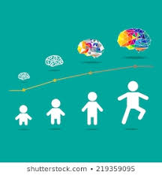
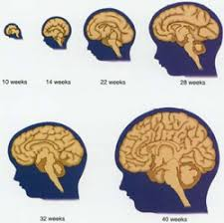
The basic architecture of the brain is constructed through an ongoing process that begins before birth and continues into adulthood.

Slide 4
The functional unit of the brain is ‘Neuron’ neuroscience can be studied at many different levels ranging from molecular level to cellular level.
Cognitive science is indebted to the field of neurosciences in general and cognitive neuroscience in particular cognitive neuroscience addresses how mental functions are supported by the brain.

Slide 5
Neuroscience and the brain
The early years of a child’s life lay the foundation for their future potential.
In the first 3 years of life, a child’s brain develops faster than at any other time, forming more than 1 million new neural connections every second.
New pathways can be developed, but early experiences establish the foundation – and change is much harder as children grow older.

Slide 6
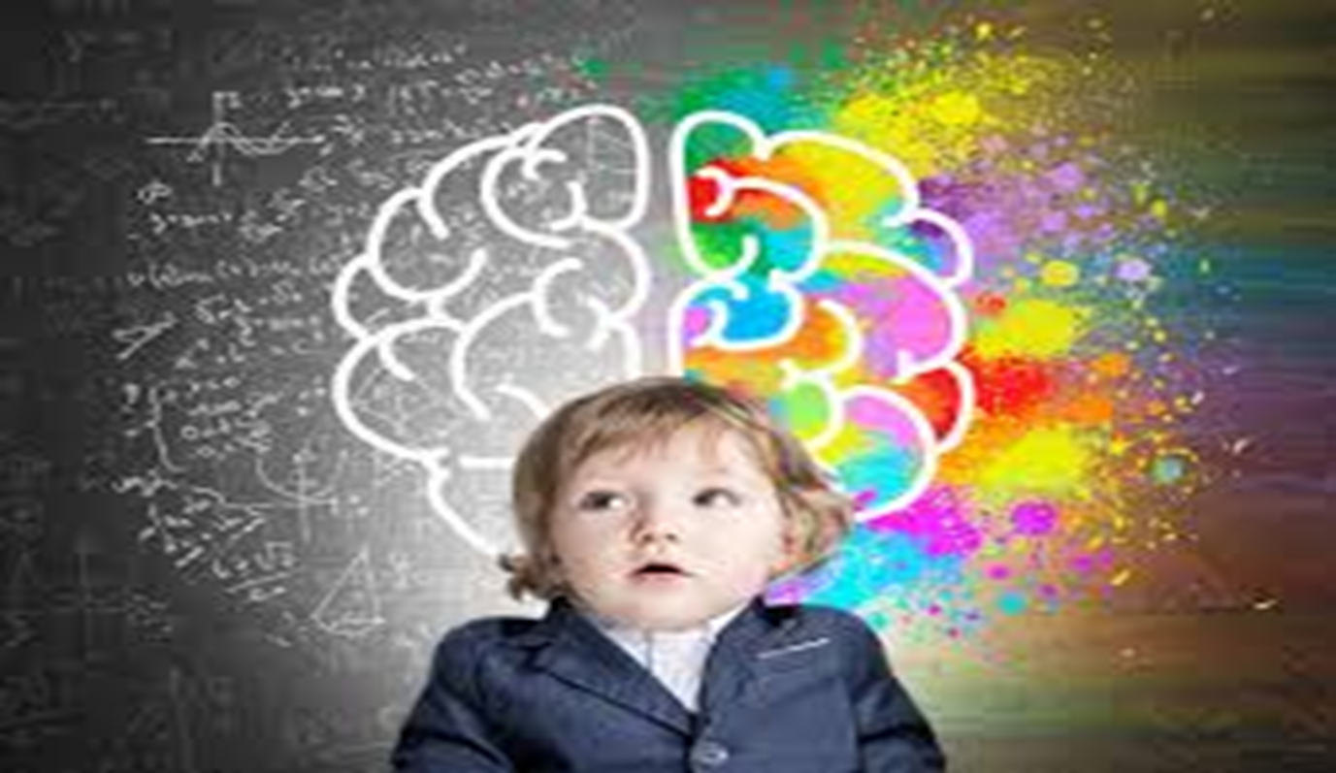
80% brain development happens before child turns 3 . The fastest rate of brain development in their whole life.

Slide 7
Neuroscientists have sought the neural substrate of human morality, which establishes biological basis of moral behaviour, using various methods, such as functional and structural neuroimaging and non-invasive brain stimulation methods (Poldrack 2008)
They have demonstrated how activity in brain regions associated with affection, cognition, motivation and other moral psychological processes are related to moral functioning.

Slide 8
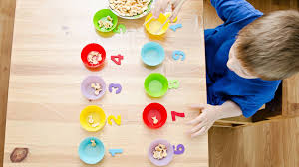
Numeracy and literacy
Children starts building the foundational skills for commination, counting, reading and writing very early and early learning builds their vocabulary and their abilities to tell stories

Slide 9
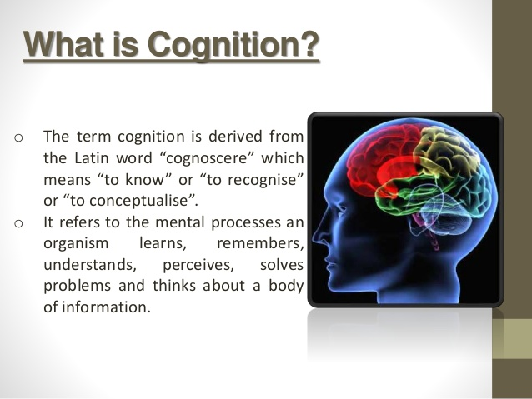

Slide 10
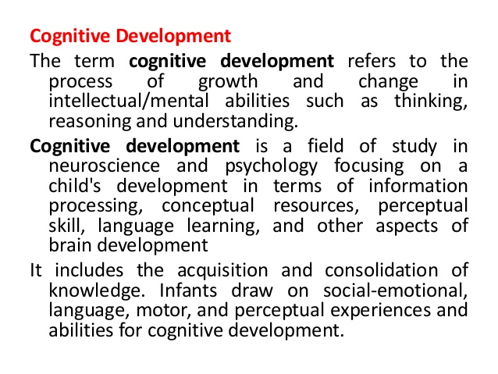

Slide 11
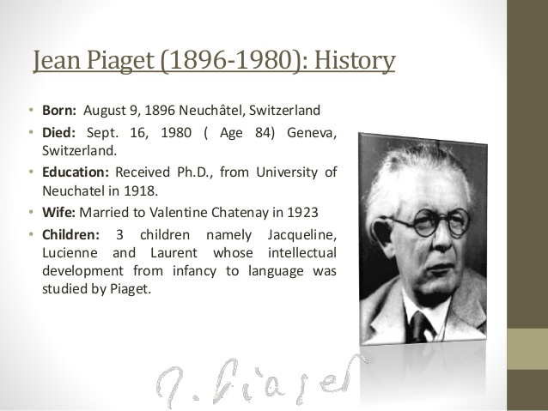

Slide 12
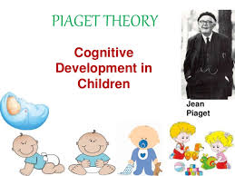

Slide 13
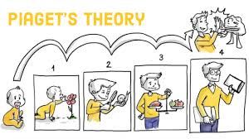

Slide 14
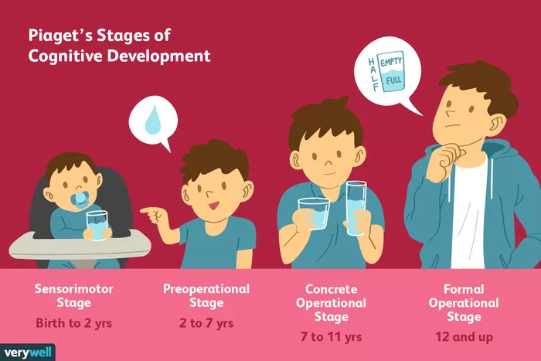

Slide 15
The Sensorimotor Stage
Major Characteristics and Developmental Changes:
The infant knows the world through their movements and sensations
Children learn about the world through basic actions such as sucking, grasping, looking, and listening
Infants learn that things continue to exist even though they cannot be seen (object permanence)
They are separate beings from the people and objects around them
They realize that their actions can cause things to happen in the world around them

Slide 16
The Preoperational Stage
Major Characteristics and Developmental Changes:
Children begin to think symbolically and learn to use words and pictures to represent objects.
Children at this stage tend to be egocentric and struggle to see things from the perspective of others.
While they are getting better with language and thinking, they still tend to think about things in very concrete terms.

Slide 17
The Concrete Operational Stage
Major Characteristics and Developmental Changes:
During this stage, children begin to thinking logically about concrete events
They begin to understand the concept of conservation; that the amount of liquid in a short, wide cup is equal to that in a tall, skinny glass, for example
Their thinking becomes more logical and organized, but still very concrete
Children begin using inductive logic, or reasoning from specific information to a general principle

Slide 18
The Formal Operational Stage
Major Characteristics and Developmental Changes:
At this stage, the adolescent or young adult begins to think abstractly and reason about hypothetical problems
Abstract thought emerges
Teens begin to think more about moral, philosophical, ethical, social, and political issues that require theoretical and abstract reasoning
Begin to use deductive logic, or reasoning from a general principle to specific information

Slide 19
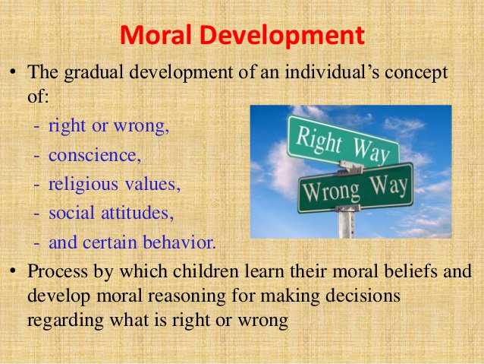

Slide 20
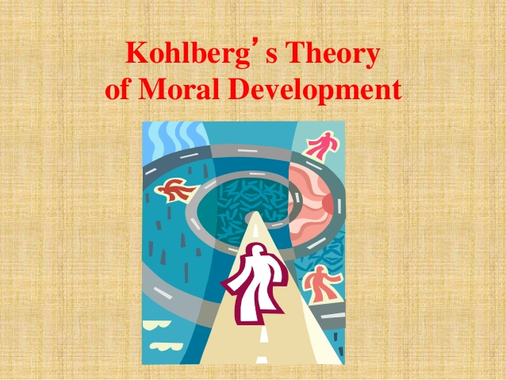

Slide 21
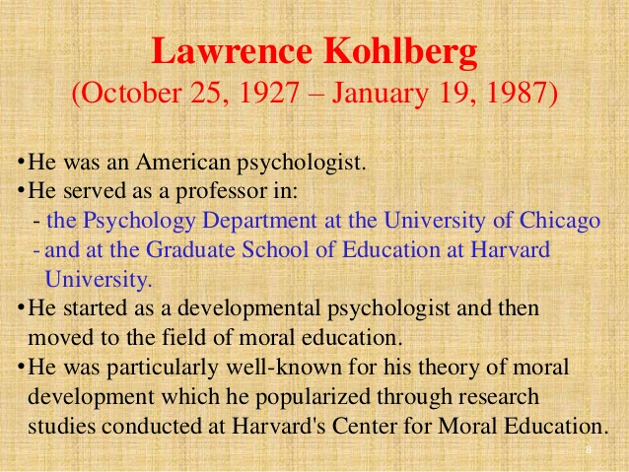

Slide 22
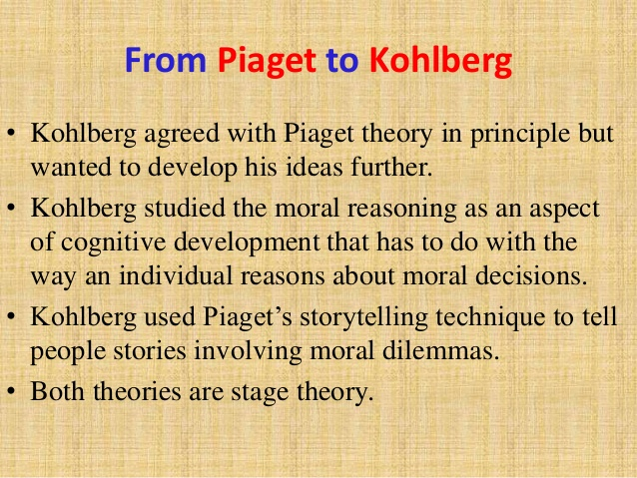

Slide 23
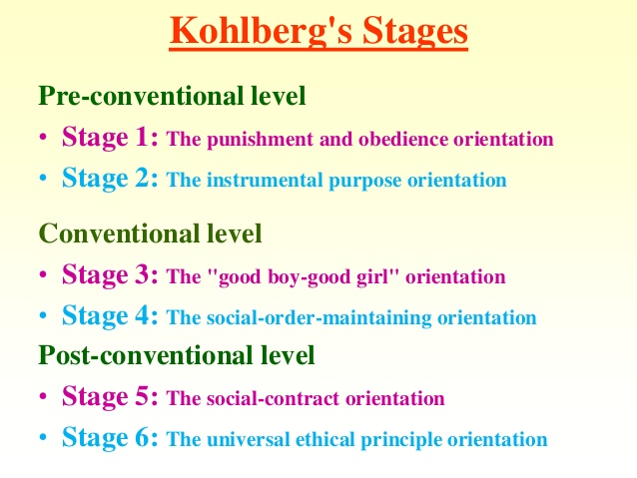

Slide 24
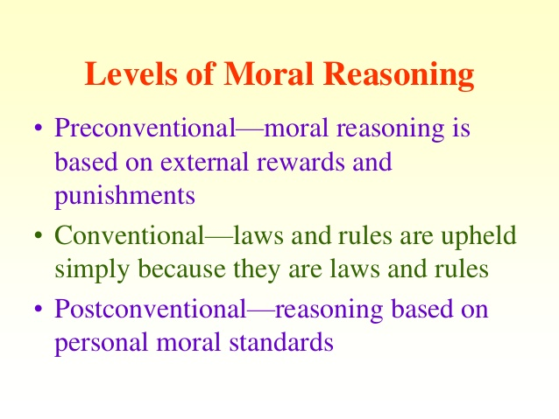

Slide 25
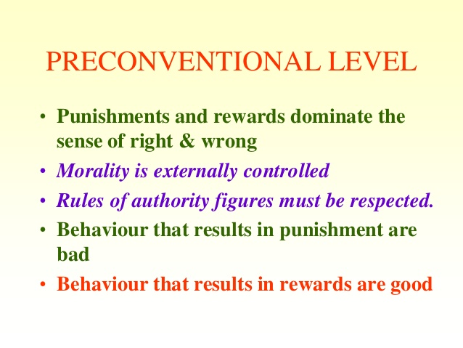

Slide 26
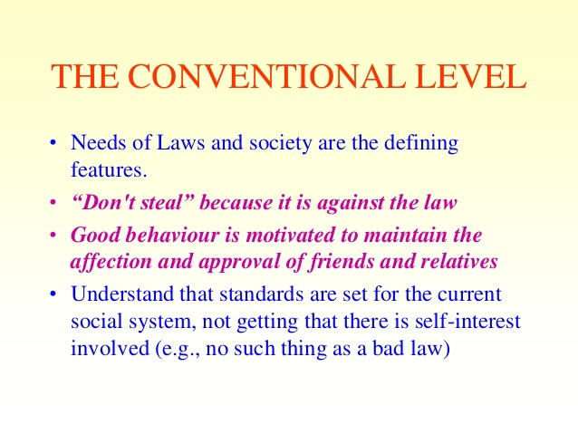

Slide 27
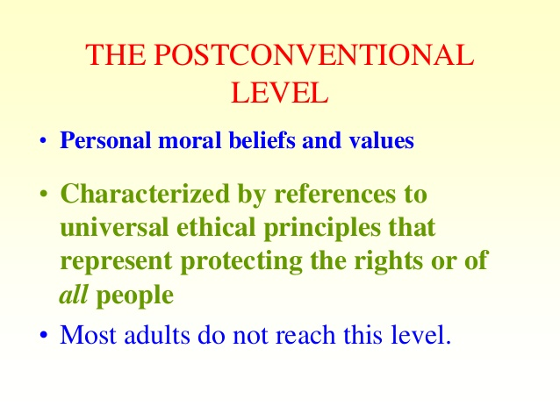

Slide 28
RELIGIOUS VALUES
HELPFULNESS
GENOROSITY
GIVIGING CHARITY
LOVE FOR ANIMAL WORLD/ENVIRONMENT
CLEANLINESS LOVE OF KNOWLEDGE
COURAGE

Slide 29
The objective of early childhood education is to establish a foundation for the development of a child’s character, behaviour, knowledge, skills and creativity to spur further development and growth.
There are six aspects of development:
Moral and Religious Values;
Social and Emotional Development and Independence
Language ability
Cognitive ability
Motor ability
Artistic ability.

Slide 30
Importance of early childhood care and education
The future of any society depends on its ability to foster the health and well-being of the next generation.
Today’s children will become tomorrow’s citizens, workers, and parents.
When we fail to provide children with what they need to build a strong foundation for healthy and productive lives, we put our future prosperity and security at risk.
Science has a lot to offer about how we as a community can use our collective resources most effectively and efficiently to build that strong foundation.

Slide 31
When we invest wisely in children and families, the next generation will pay that back through a lifetime of productivity and responsible citizenship.
When we do not make wise investments in the earliest years, we will all pay the considerable costs of greater numbers of school-aged children who need special education and more adults who are under-employable, unemployable, or incarcerated
When we invest wisely in children and families, the next generation will pay that back through a lifetime of productivity and responsible citizenship.

Slide 32
Early childhood education must be optimized through appropriate parenting and education patterns.
Therefore, it is necessary to choose the right learning model, which scientific approach based so that the learning objectives can be achieved and the students ‘reasoning ability is increasingly developed through the learning process.
The scientific approach is considered as an effective way in cultivating students ‘creativity, imagination, and ideas to develop the aspect of religious and moral values,

Slide 33
In this regard, teachers are then required to have creativity in designing scientific-based activities to foster students‘ understanding, so that the development of religious and moral values optimally achieved and internalized in their daily lives properly.
Through learning activities while playing, direct demonstrations and concrete examples, children will learn easily.
In addition, critical thinking skills are needed to help children receive material that is not in the form of physical-material.

Slide 34
THANKS

